Slide 1









Idea submission

Slide 2


Team details
Team Lead: Goutham TG
Contact: 7892468158
Email:gouthamtaranagar.ai23@bmsce.ac.in
Team Member 2:
Name: Abhishek
Contact: 8439732355
Email: abhishek.ai23@bmsce.ac.in
Team Member 3:
Name: Anant sharma
Contact: 9661468169
Email: anantsharma.is23@bmsce.ac.in

Slide 3


Our solution
Zenify AI: Plug-and-Play Voice Agent for Businesses
🔧 What It Is
AI-powered voice assistant for businesses
Built as a plug-and-play widget (1 line of script)
Works for customer support, bookings, sales etc.
📝 How It Works
Business owner fills a setup form (type, services, tone, etc.)
We generate a custom prompt using OpenAI GPT (basically to understand user’s needs)
The prompt is saved in backend and reused on calls
Website visitors click mic → talk → hear reply
💡 What It Does
Converts voice → text (via Whisper STT)
Feeds text to GPT-3.5 Turbo
Returns natural, human-like replies
Speaks reply back using browser TTS

Slide 4
TECH STACK
Component | Technology Used
Frontend | React.js (Vite) + Tailwind CSS
Voice Input UI | MediaRecorder API + File Upload via REST
Speech-to-Text (STT) | OpenAI Whisper API
AI Chatbot / NLP Engine | OpenAI GPT-3.5 Turbo (via openai.chat.completions.create)
Voice Output (TTS) | Browser SpeechSynthesis API
Backend | Node.js with Express
Database | MongoDB (via Mongoose ODM)
Prompt Generation | Custom summarizer powered by GPT-3.5 Turbo
Call Transcripts Storage | MongoDB - Agent model with dynamic transcripts[]
Business Customization | No-code Setup Form ➝ Autogenerated prompt ➝ Saved per business
Deployment | Localhost (Dev), ready for Railway/Render/Heroku or AWS EC2
API Format | REST API (Multer for file handling, JSON for prompt)
Authentication (optional) | JWT-based or OAuth2 (future implementation)
Voice Widget Integration | 1-line <script> widget — embeddable on any business site

Slide 5
IMPLEMENTATIONs
AI-Powered Customer Service Desk (24/7)
AI Receptionist / Appointment Booking
Voice-Based Sales Assistant
Multilingual Support Agent
Embedded AI Widget on Any Website
Call Transcript + Insight Generator
Voice Feedback Collector

Slide 6

TECHNICAL APPROACH
Frontend (React) → Captures user voice using MediaRecorder API and sends audio to backend.
Backend (Node.js + Express) → Receives audio, handles STT, GPT logic, and TTS prep.
Speech-to-Text (OpenAI Whisper API) → Transcribes user voice into plain text.
Prompt Retrieval (MongoDB) → Fetches AI assistant prompt specific to that business.
Natural Language Understanding (GPT-3.5 Turbo) → Generates smart replies using prompt + user input.
Text-to-Speech (Browser SpeechSynthesis) → Converts GPT reply into speech in real-time on browser.
Data Storage (MongoDB) → Saves transcript, GPT reply, duration, and call stats per business.
Script Embedding (1-line Widget) → Allows businesses to add Zenify AI to any site via <script>.
Real-Time Streaming (WebSockets / REST) → Enables low-latency interaction with audio chunks or messages.
Multilingual Support → User input is processed and answered in regional languages if needed.

Slide 7
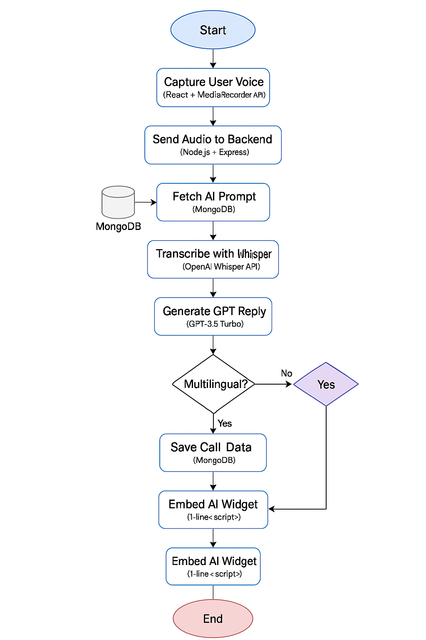
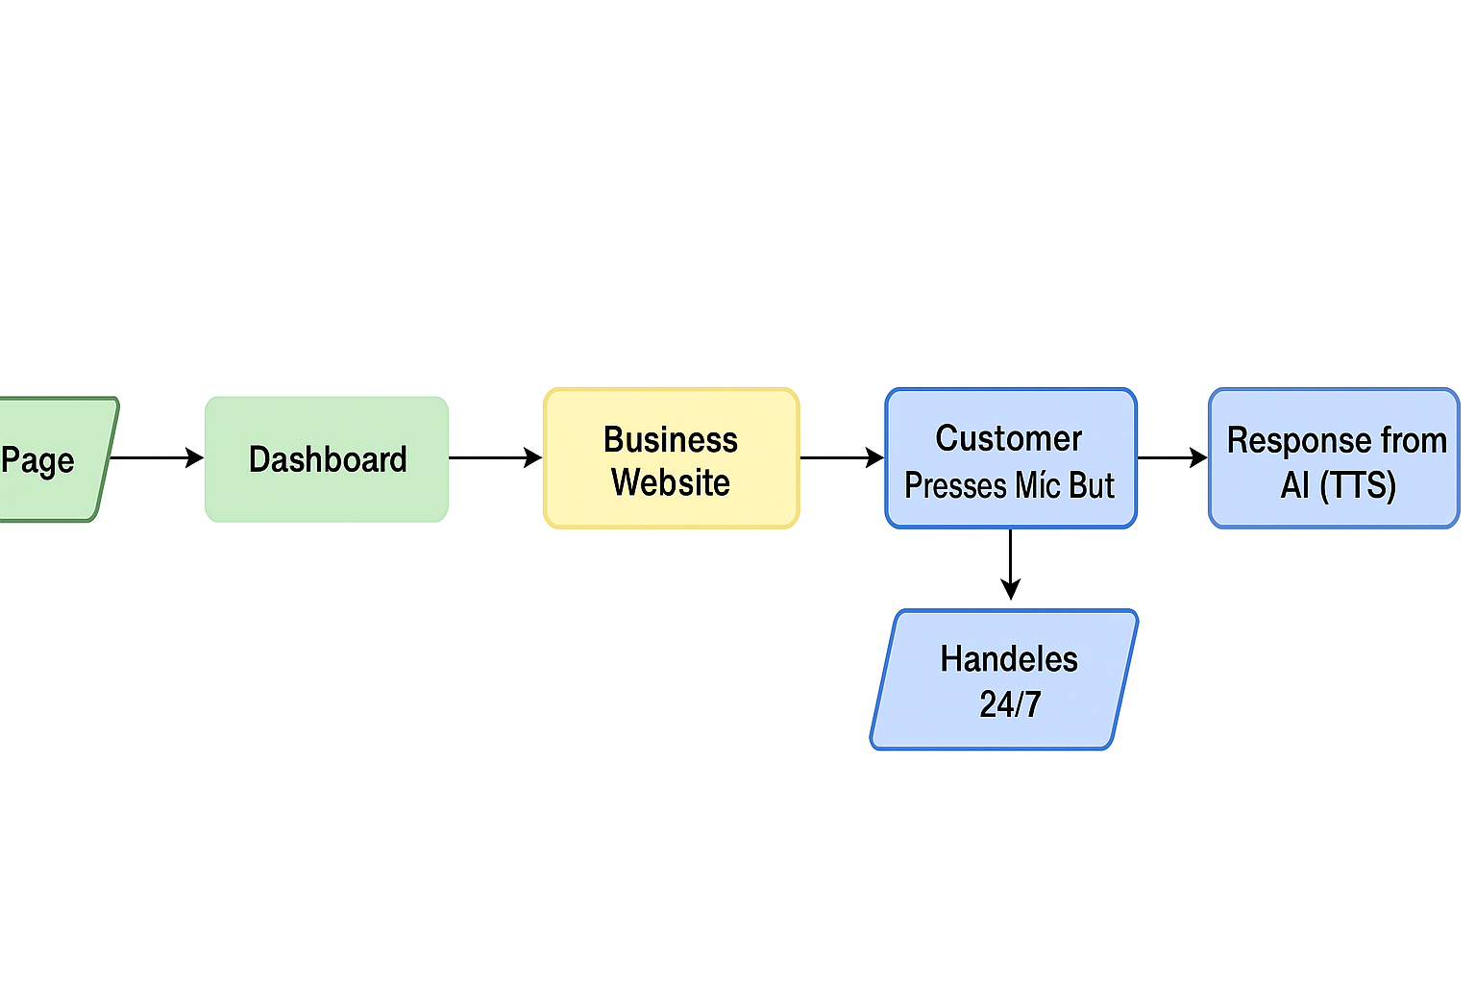
Workflow/pipeline

Slide 8
Feasibility & FUTURE SCOPE
✅ Pros of Our Implementation
Plug-and-Play Simplicity → Businesses can generate an AI agent with 0 technical skills.
API-Free Frontend → No SDKs or libraries—just a 1-line script to embed.
Browser-Based Voice I/O → No external TTS needed (uses SpeechSynthesisUtterance), saving infra cost.
Scalable Backend Logic → Dynamic prompt generation, STT, and GPT handled via REST endpoints.
Low Latency → Whisper + GPT give fast results (<5s per message) for responsive calls.
Custom Role-Based Agents → Each agent speaks in tone/voice based on business goals.
❌ Cons of Our Implementation
Browser Limitations for TTS → No multilingual/advanced emotion support via native speechSynthesis.
No Realtime Audio Streaming → Calls are chunked every 5 seconds, not truly continuous.
OpenAI Dependence → Both STT and GPT require API credits (not open source yet).
Basic UI/UX for Widget → UI is functional, not flashy (can be improved later).

Slide 9
FUTURE SCOPE
Multilingual Voice Support → Integrate ElevenLabs or Google TTS for Hindi, Tamil, etc.
Live Call Transfer → Transfer from bot to human if AI detects confusion.
Intent-Based CRM Hooks → If user says “I want to book,” AI triggers booking APIs automatically.
Speech Emotion Analysis → Use audio cues + Whisper timestamps to detect anger/frustration.
Custom Training → Fine-tune GPT on the business’s past chat/call history.

